Slide 1
BABTA Risk Management Panel – January 21, 2106
Ryan Pierce Travel Manager, Americas, Salesforce
Morne’ du Preez Senior Risk Program Manager, iJET
Ben Parodi VP Sales, American Express
Fred Dallenbach (Moderator) Partner/Sr. Consultant, CTBR

Slide 2
#1 Priority for 2016: Safety & Security
80% of GTMs rank
Safety & Security
“Very high” or “High” priority in 2016*
$25K Average cost for medical evacuation incident**
$4,000
Average cost of 3 day INTL business trip**
*Source: CWT 2016 Travel Trends & Program Priorities
**Source: iJet 2015Travel Risk Management & Maturity Model TRM3

Slide 3
Travel Risk Management Questions
Does your organization have a defined, documented and maintained Travel Risk Policy?
Does your organization provide and keep record of Travel Safety training for your travelers?
Does your organization have Emergency Response plans, linked to Business Continuity plans for all global locations? Yes/No.
Do these plans take into consideration travelers and Expats ( and their dependents)
What documented pre-trip risk based travel approval process does your organization have in place?
What happens when things go wrong?

Slide 4
Travel Risk Management (TRM)
A well defined process to identify risks, prepare travelers pre-trip, monitor threats, and respond to incidents as they arise.
Proactive
_{Feedback}
Planning
Training
24x7
Monitoring
Incident
Response
Reactive

Slide 5
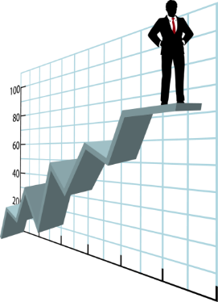
Measuring TRM Program Maturity Level
Level 5: OPTIMIZED
Full ownership with active program maintenance, testing, exercising and continuous improvement. Fully integrated throughout organization
Level 4: MANAGED
Ownership is established at most or all organizational levels. Cross-organization support. Metrics collected and reviewed.
Level 3: PRO-ACTIVE
Consistent execution of operational risk management processes. Program communicated throughout the organization.
Level 2: DEFINED
Basic programs and procedures are defined and document. Full adoption is uncertain. Primary focus remains on response.
Level 1: REACTIVE
Ad hoc actions with little or no systematic procedures / policies. Chaotic during an emergency.

Slide 6
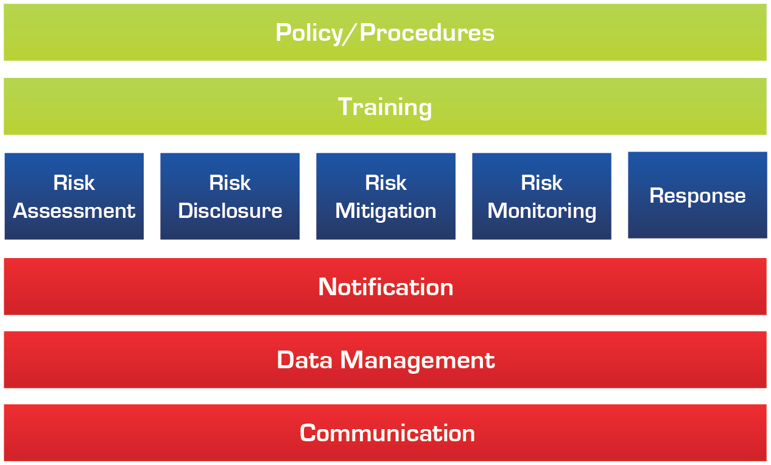
TRM Key Process Areas
Overarching KPAs
Management KPAs
Infrastructure KPAs

Slide 7
Top 10 Reasons Programs Fail

Slide 8
Next Steps
Review & benchmark your program & policy; GBTA/iJet TRM3 Travel Risk Management & Maturity Model
Available on GBTA Hub, TRM3 “Travel Risk Management Self Assessment”
Engage key providers, such as iJet, I-SOS as well as your TMC
Network with travel manager peers
Establish internal relationships & dialogue with key departments such as:
Risk Management
HR, Legal, IT
Business Continuity, Operations
Global stakeholders

Slide 9
BABTA Risk Management Panel
Be safe.
Thank you.

Slide 10
Resource Slides
Additional Resource Slides

Slide 11
Who Owns Duty of Care?

Slide 12
Travel Safety Continuum

Slide 14
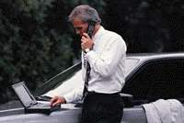
Multidisciplinary Process
TRAVEL
Advisor and knowledge base
Books trips and handles travel issues
Provides reporting
SECURITY
Risk assessment
Crisis & evacuation plans
Emergency contact info
Global response
HR/LEGAL
Responsible for all employees
Policy & procedures
Corporate insurance programs
MEDICAL
Pre-trip health planning
Immunizations
Medical assistance & evacuations
_{Traveler}

Slide 15
Key Questions To Begin

Slide 16
Travel Risk Management Maturity Model (TRM3)

Slide 17
How would your organization deal with….
“Freescale Semiconductor Ltd. said 20 employees from its operations in Asia were passengers on Malaysia Airlines Flight MH370, which was en route from Kuala Lumpur to Beijing before authorities lost contact with the aircraft.”
http://www.wsj.com/articles/SB10001424052702304554004579428082732911134
How does this impact us?
Reputational impact
Legal impact
Insurance impact
Business Continuity and business loss
Intellectual Property loss

